Slide 1
CPRG 102: .NET Development with MVC
Module 11: Dependency Injection

Slide 2
Topic 1 Introduction to DI

Slide 3
Separation of Concerns
“Defined, the Dependency Inversion Principle (DIP) states that high-level classes should not depend on lower-level classes. Instead, high-level classes should always depend on abstractions of their required lower-level classes. In a way, this principle is a specialization of one of the pillars of object-oriented design; program to an interface, not to an implementation.”
(Esposito, 2014)

Slide 4

Terminology
A number of related software engineering terms exist:
Inversion of Control (IoC)
Dependency Inversion Principle (DIP)
Dependency Injection (DI)
Concepts are all related but not the same: DIP != DI
Class diagram is meant to show that IoC is a high-level concept, whereas DI is granular in its implementation

Slide 5
What is Inversion of Control?
A high-level design principle
Object creation is not the responsibility of the consuming class but delegated to an external framework (or container)
Decoupling is a big part of IoC
IoC advocates agreed that the term was too general in nature
A new name was settled on: Dependency Injection

Slide 6
What is Dependency Inversion?
A design principle with two parts
High-level classes don’t depend on low-level classes
High-level classes depend on abstractions of their required low-level classes
Focus is programming to an interface
An inversion of control is implemented when dependencies are encountered
DIP implemented by one of two patterns
Service Locator
Dependency Injection

Slide 7
What is Service Locator?
Basically a factory
Responsible for looking up components and creating instances of a defined type
Handles pooling of instances
Hides complexity of looking up a component
Caller does not need to specify what the concrete type is – usually just the interface or base class name

Slide 8
What is Dependency Injection?
DI is an implementation of DIP
DI addresses the problem of dependencies that cause tightly coupled code
DI is a design pattern that enables creation of loosely coupled classes
All dependencies are passed into the class requiring them (injected), usually through a constructor (or property)

Slide 9

Tightly Coupled Classes
EntityManager class contains a reference to EntityService, a concrete class
EntityService is instantiated internally by EntityManager
Updating or modifying EntityService requires a change to EntityManager

Slide 10
Code Example
public class EntityService{ ... }
public class EntityManager
{
private EntityService _service;
public EntityManager()
{
_service = new EntityService();
}
}

Slide 11
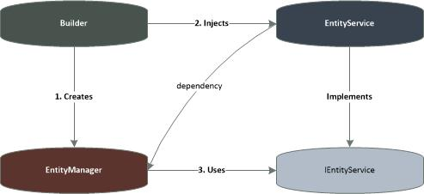
Loosely Coupled Classes
EntityManager class references an interface IEntityService not EntityService
EntityService can be replaced or modified without changes to EntityManager
DI implemented through an IoC container

Slide 12
Code Example
public interface IEntityService { ... }
public class EntityService : IEntityService { ... }
public class EntityManager {
private EntityService _service;
public EntityManager(IEntityService service) {
//service injected through a constructor
_service = service;
}
}

Slide 13
Common .NET IoC Frameworks
A number of containers exist and are not limited to the following common frameworks:
Unity (Microsoft implementation)
Castle Windsor (open source)
StructureMap (open source)
Ninject (open source)
Spring.NET (open source)
Autofac (open source)
Most are available using NuGet

Slide 14
Topic 2 DI Capability in ASP.NET Core

Slide 15
DI as a First-Class Feature
With the new release of ASP.NET Core, dependency injection (DI) is baked right into the foundation.
The open source team added DI as a first-class feature not an add-in as previous versions.
Other IoC frameworks can be plugged in as long as IServiceProvider is implemented.
The built-in DI container can also be used outside of ASP.NET Core because the code is not defined in Microsoft.AspNetCore namespace

Slide 16
Registering the Service
All services are registered in ConfigureService method of the Startup class
Register with one of these four options:
Transient: services created for each request
Singleton: services created once at first request
Scoped: services created once per request in current scope
Instance: Similar to singleton, except the instance is created immediately within the ConfigureService method, not when first requested

Slide 17
Code Example
//In the Startup class (in the Startup.cs file)
public void ConfigureServices(IServiceCollection sc)
{
sc.AddMvc();
sc.AddTransient<IStudentService,StudentManager>();
}
//In the domain layer
public interface IStudentService { ... }
public class StudentManager : IStudentService{ ... }

Slide 18
Code Example cont’d
//In the Student Controller code
IStudentService Service {get; set;};
//The dependency is injected
public StudentController(IStudentService svc) {
Service = svc;
}
public IActionResult Index() {
var students = Service.GetStudents();
return View(students);
}

Slide 19
Topic 3 ServiceCollection Extensions

Slide 20
What if?
Remember this code?
public void ConfigureServices(IServiceCollection sc)
{
sc.AddMvc();
services.AddDbContext<CTTIContext>(options =>
options.UseSqlServer(connString));
sc.AddTransient<IInstructorService,InstructorService>();
}
What if we had 10, 20 or more services to register?
The ConfigureServices method would look pretty messy
Better solution is to use an extension method pattern and appsettings.json for the connection string

Slide 21
The ServiceCollection Pattern
//In some file in the project
public static class IServiceCollectionExtension
{
public static IServiceCollection AddManagerServices(
this IServiceCollection services,
IConfiguration configuration)
{
//connection string stored in appsettings.json file
var connString =
configuration.GetConnectionString("CttiConnection");
services.AddTransient<IInstructorService,
InstructorService>();
services.AddDbContext<CTTIContext>(options =>
options.UseSqlServer(connString));
return services;
}
}

Slide 22
The New Startup Class Code
//partial code follows:
public IConfiguration Configuration { get; }
Public void ConfigureServices(IServiceCollection services)
{
services.AddMvc();
//call to the new extension method
services.AddManagerServices(Configuration);
}

Slide 23
Topic 4 Setting up an IoC Container
(for MVC 5)

Slide 24
Working with Unity (MVC 5)
Add Microsoft Unity to the Application using NuGet:
Right click the project
Select “Manage NuGet Packages…”
Enter “Unity” in the Search field
Select Unity.MVC for an MVC application or Unity.WebAPI for a WebAPI application
Register your types in the UnityConfig.cs file found in the App_Start folder of the project

Slide 25
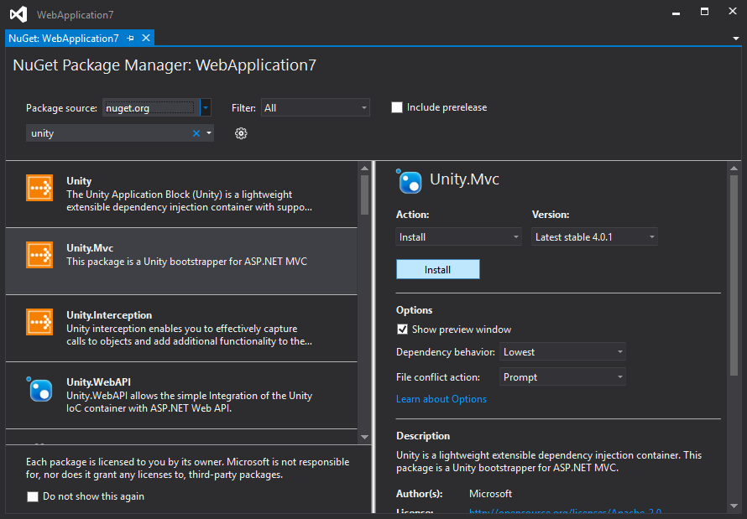
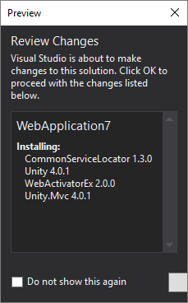
Installing Unity MVC or WebAPI

Slide 26
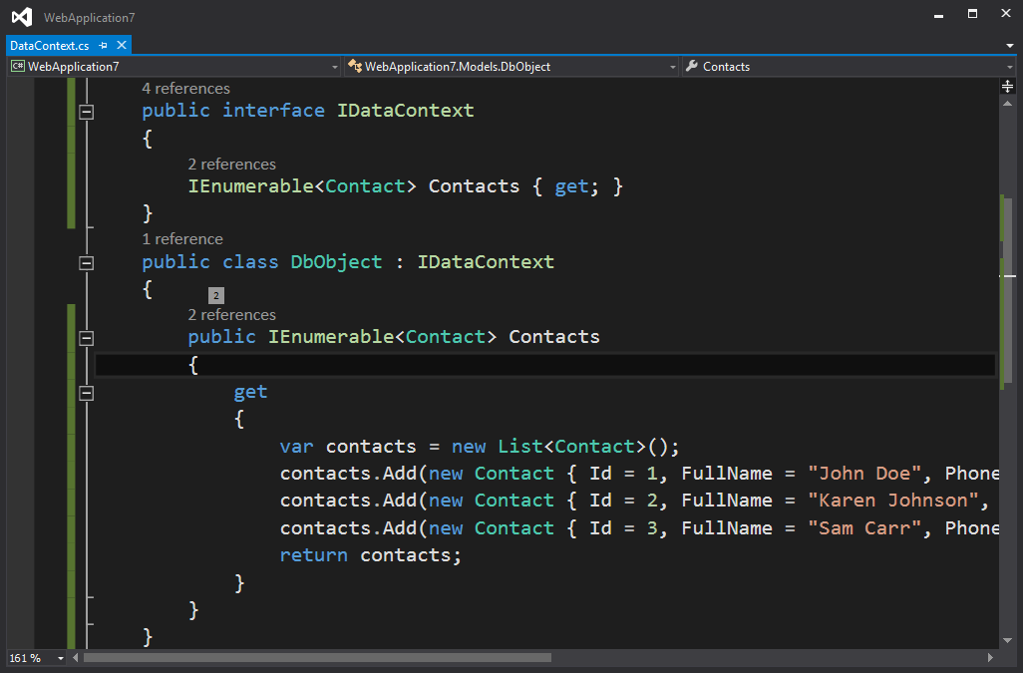
Resolving Dependencies

Slide 27
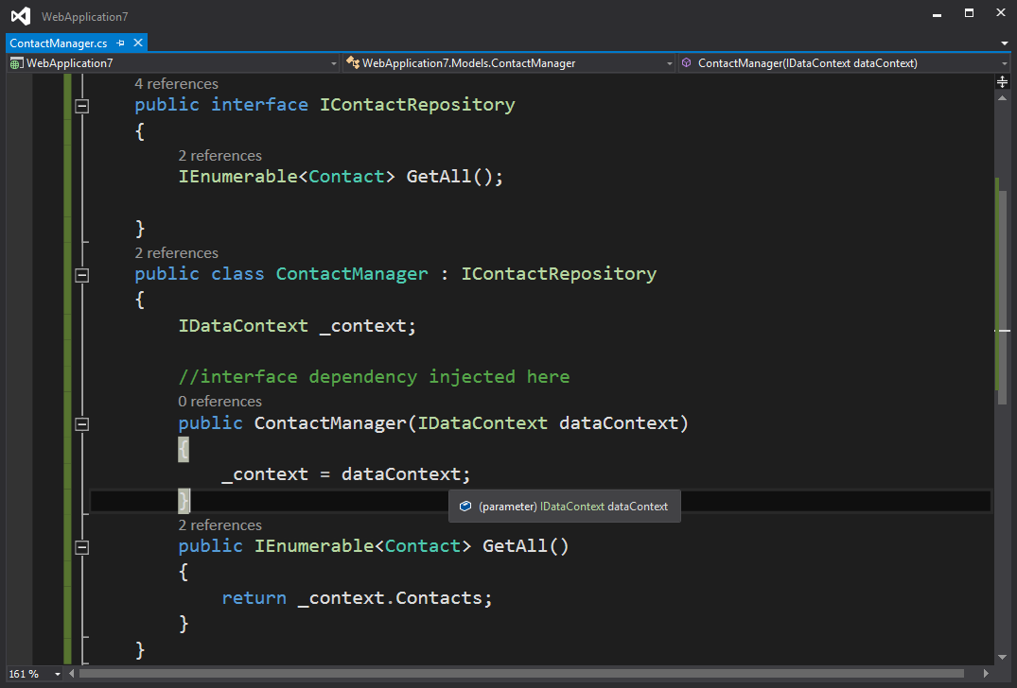
Resolving Dependencies cont’d

Slide 28
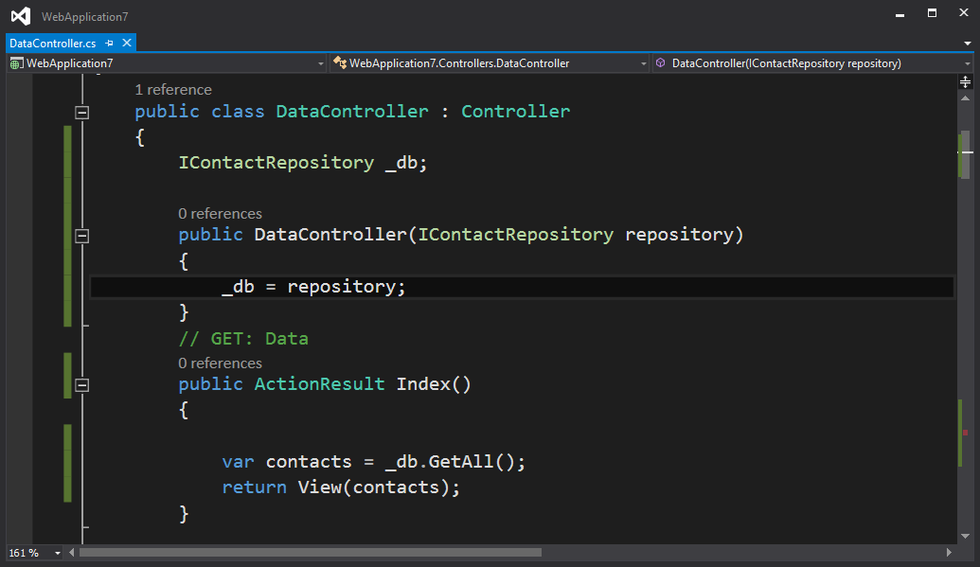
Resolving Dependencies cont’d

Slide 29
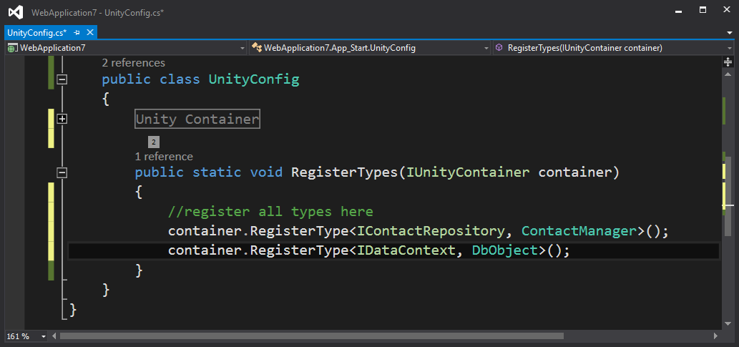
Registering the Types

Slide 30
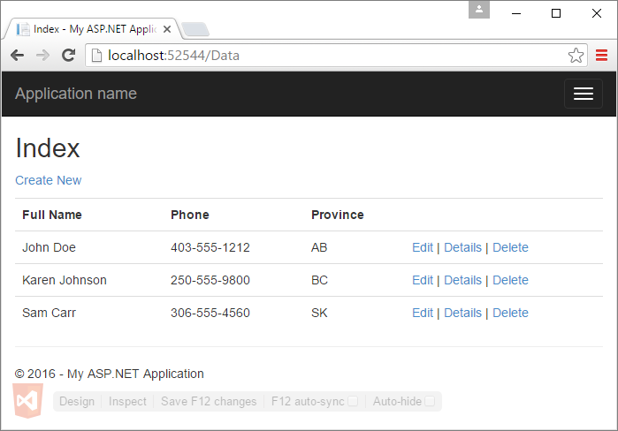
The View Display

Slide 31
Demonstrations
In the demonstrations for this module, you will see:
How to use dependency injection in ASP.NET Core MVC

Slide 32
Resources
Esposito, D. (2014). Programming Microsoft ASP.NET MVC (3rd ed.). Sebastopol, California: O’Reilly Media.

Slide 33
© 2017, Southern Alberta Institute of Technology. All rights reserved.
This publication and materials herein are protected by applicable intellectual property laws. Unauthorized reproduction and distribution of this publication in whole or part is prohibited.
For more information, contact:
Director, Centre for Instructional Technology and Development
Southern Alberta Institute of Technology
1301 16 Ave. N.W., Calgary, AB T2M 0L4

